Slide 1
Global patterns of Temperature and heat
Week 3

Slide 2
Review
Five Primary Reasons for the Seasons:
Earth’s Orbit
Earth’s Rotation
Tilt of the Earth’s Axis
Axial parallelism
Sphericity
**All five of these work together to create the seasonality of a location

Slide 3
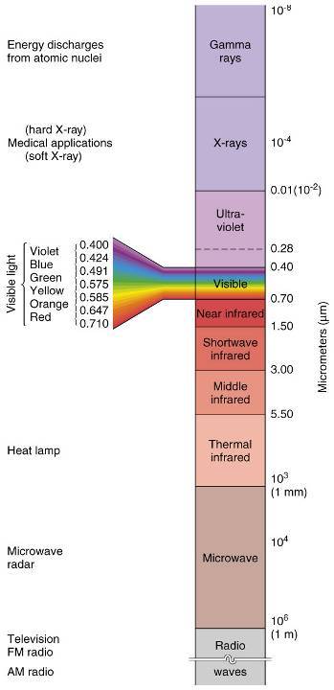
Review
HIGH
We can represent the range of wavelengths emitted by the sun into the sun’s EM Spectrum
Visible light and infrared wavelengths
Note which are low and high frequency waves
LOW

Slide 4
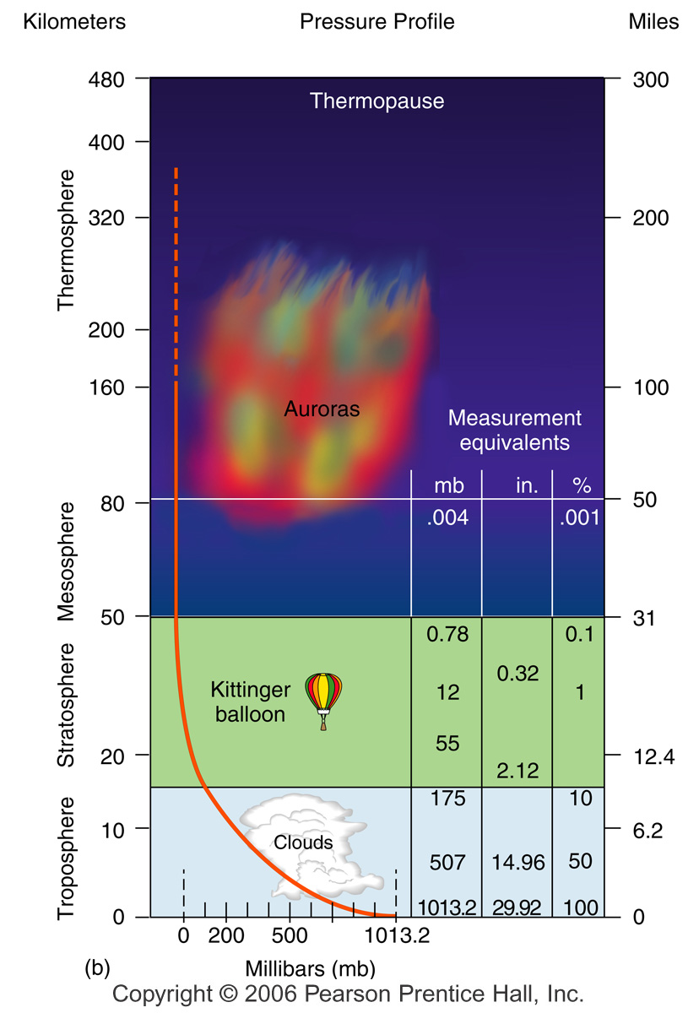
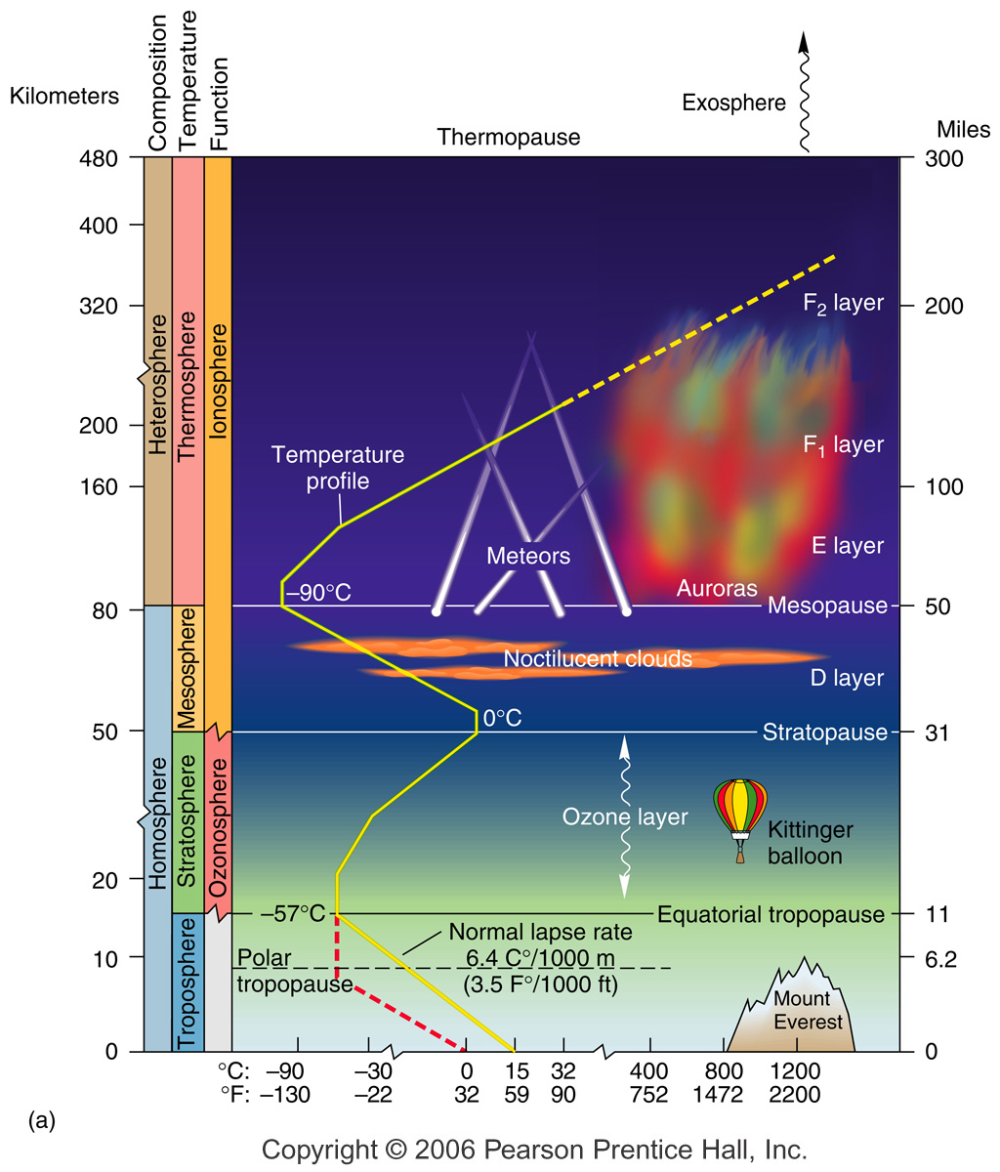

Slide 5
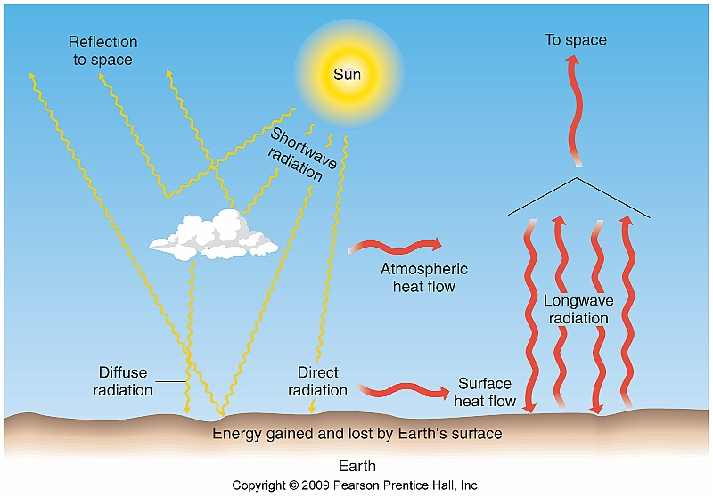
Energy Pathways and Insolation
Passage of shortwave and longwave energy through either the atmosphere or water is transmission

Slide 6
Insolation Input
Four ways incoming energy is transmitted:
Scattering
Refraction
Reflection
Absorption

Slide 7
Scattering (Diffuse Radiation)
Scattering - The molecules change the direction of the insolation without changing the wavelength.
Diffuse radiation is the downward component of scattered light

Slide 8
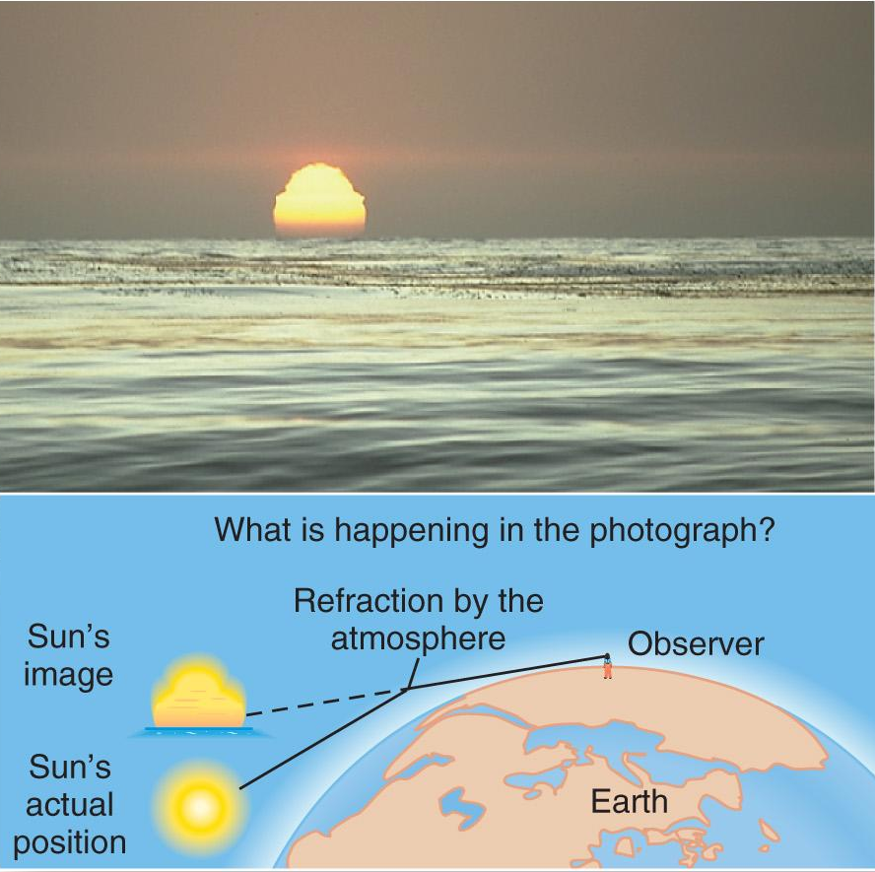
Refraction
Changes in density through which insolation passes causes a change in its direction and speed
Light is bent
(refraction)

Slide 9
Reflection
Reflection – energy hitting Earth and bouncing back into space, without being absorbed or performing work
Albedo – the reflective quality of a surface measured in percent
Controls the amount of absorption for a surface

Slide 10
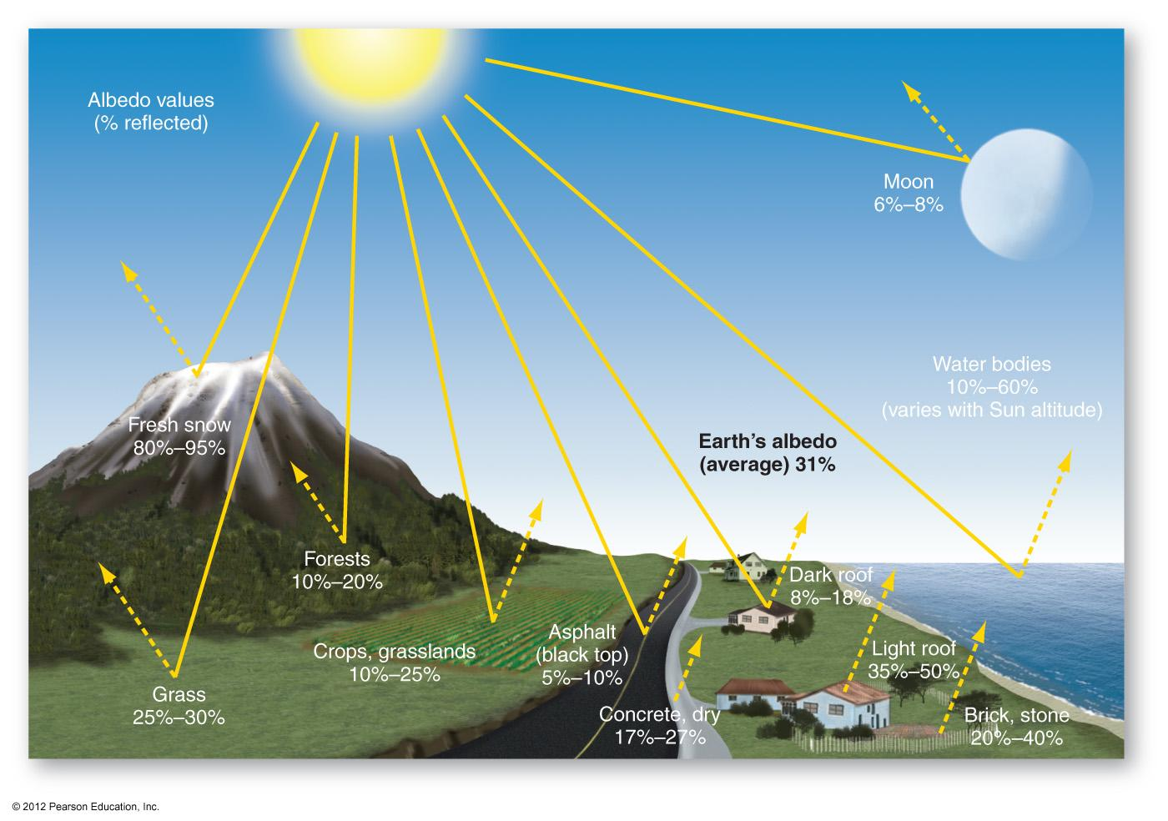
Albedo
What do you think would happen if Earth’s albedo increased?

Slide 11
Absorption
Absorption – assimilation (take in) of radiation by molecules of matter and its conversion from one form of energy to another
Plants absorb energy for photosynthesis
Converted to longwave radiation

Slide 12
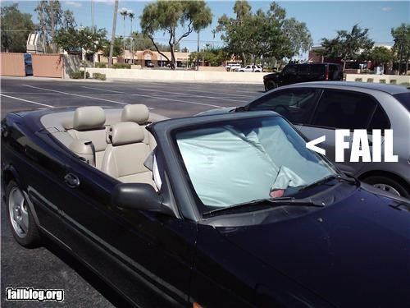
The Greenhouse Effect
Incoming shortwave energy passes through the atmosphere
Outgoing longwave energy is absorbed by the atmosphere and emitted back to Earth

Slide 13
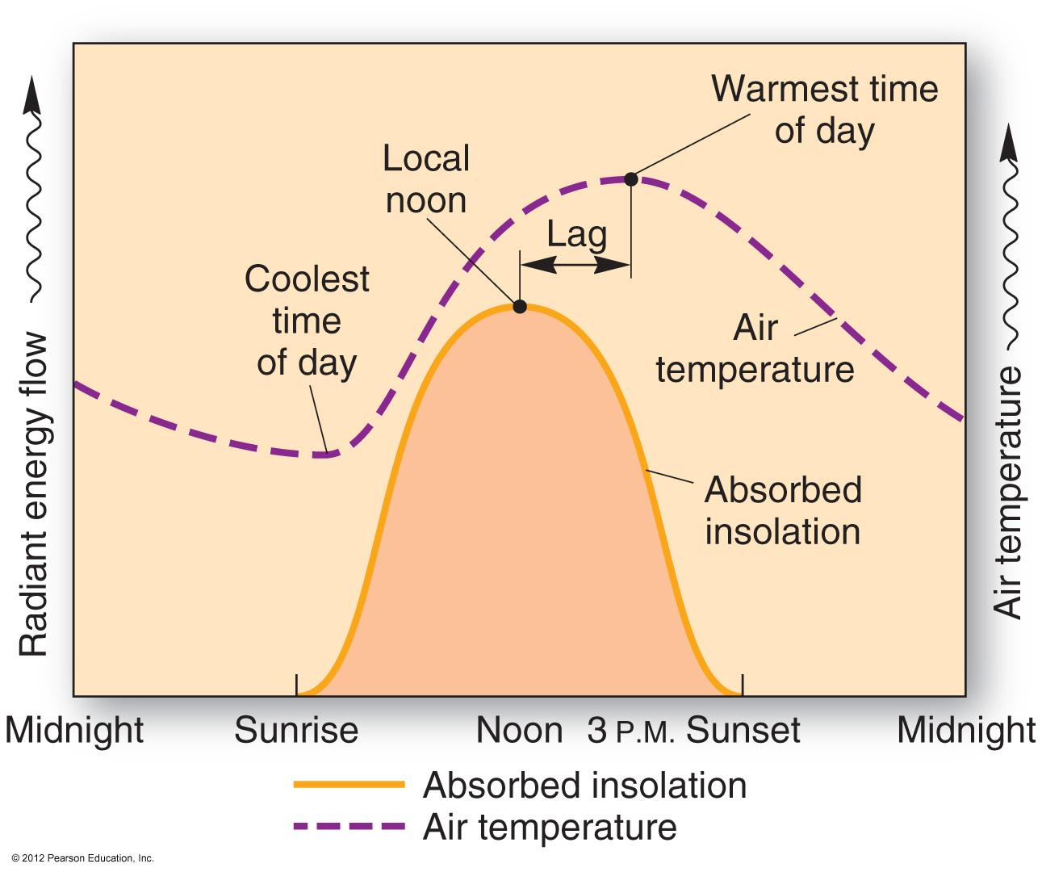
Daily Radiation Patterns
The insolation curve and air temperature curve do not align.
A lag exists

Slide 14
And break! Any questions? How do you feel on long and shortwave radiation? Do you feel solid on the relationships between frequency, wavelength, and temperature?
Let’s delve into heat next!

Slide 15
Introduction to Heat
Four modes of heat transfer on Earth:
Conduction – molecule-to-molecule
Convection – physical mixing of gas or liquid in a vertical motion
Advection – physical mixing of gas or liquid in a horizontal motion
Radiation – transfer using electromagnetic waves

Slide 16
Introduction to Heat
Latent heat of evaporation – the energy stored in water vapor as water evaporates
Water absorbs energy to change from liquid to gas
Sensible Heat – back-and-forth transfer through convection and conduction

Slide 17
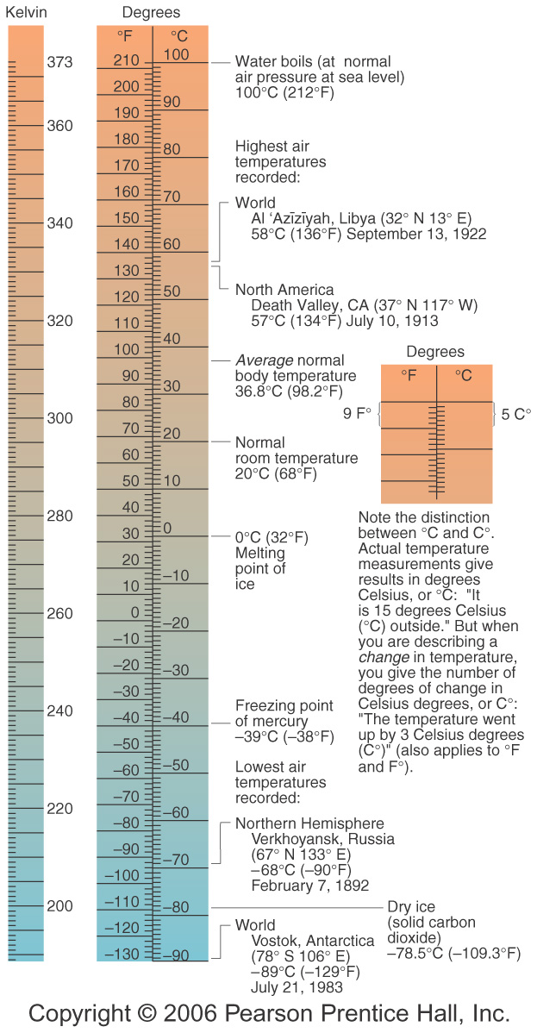
Temperature
Fahrenheit & Celsius
Kelvin
Starts at absolute zero (no molecular motion)
Readings reflect kinetic energy

Slide 18
Principal Temperature Controls
Temperature is not uniform across the globe
Influences upon temperature include:
Latitude
Altitude/Elevation
Cloud Cover
Land-Water Heating Differences

Slide 19
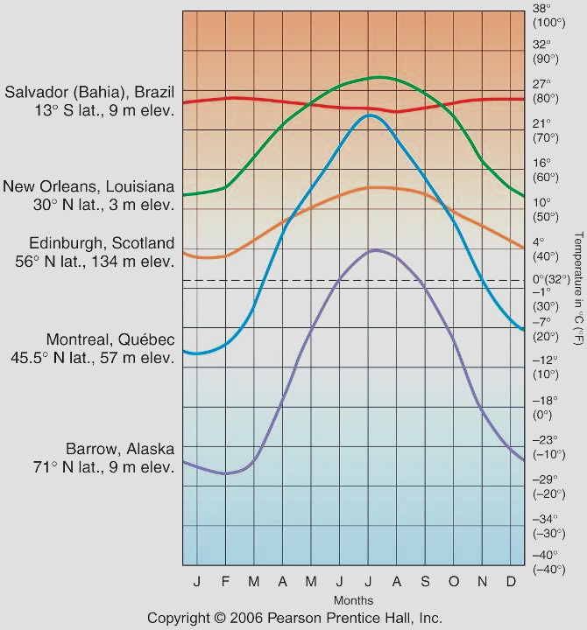
Latitude
Remember, latitude affects insolation, sun angles, and daylength

Slide 20
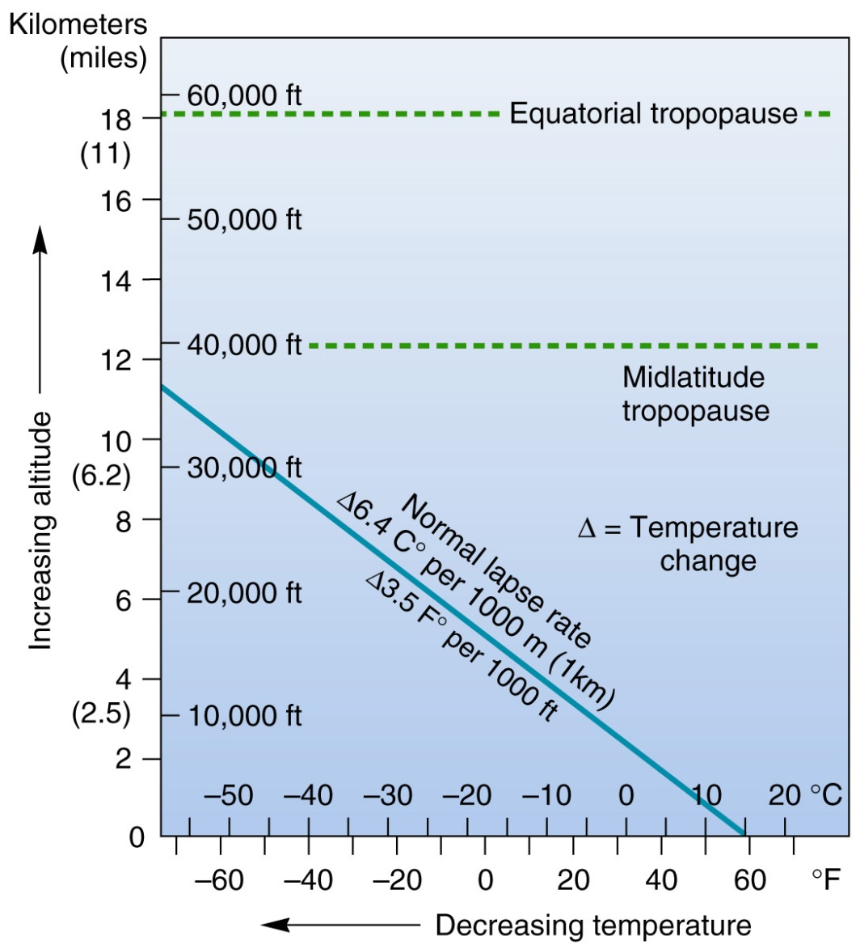
Altitude/Elevation
Temperatures decreases higher up
Thin atmosphere means less sensible heat
Normal Lapse Rate

Slide 21
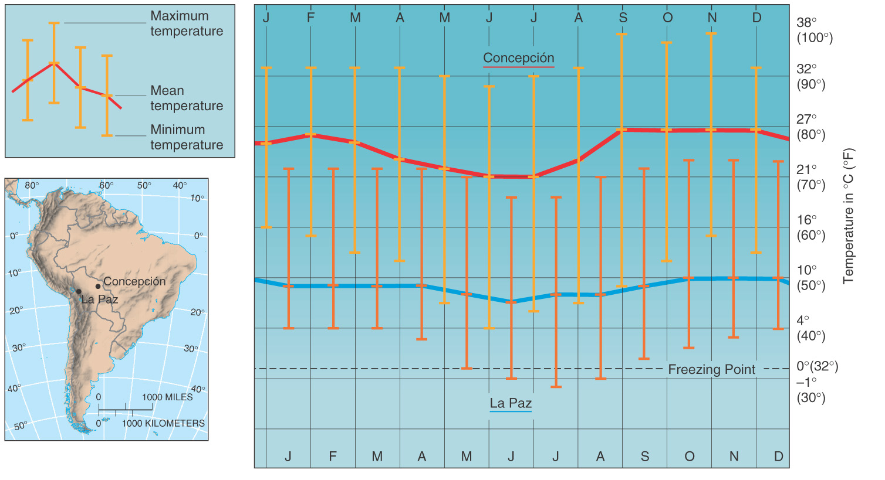
High Elevation – Notice the two city latitudes approx. match

Slide 22
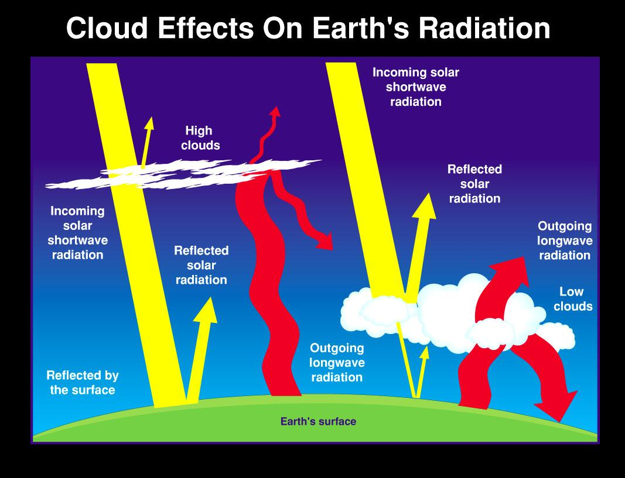
Cloud Cover

Slide 23
Land-Water Differences
Evaporation
Energy is stored as latent heat, resulting in lower temperatures
Happens more in marine locations than over land
Transparency
Land is opaque, water is transparent
Energy can penetrate deeper into water than soil, creating a larger heat reservoir

Slide 24
Land-Water Differences
Specific Heat – the heat capacity of a substance
Water heats slower, but retains heat longer
Movement
Oceans flow and mix/redistribute heat energy over a greater volume than land
Horizontal and vertical mixing

Slide 25
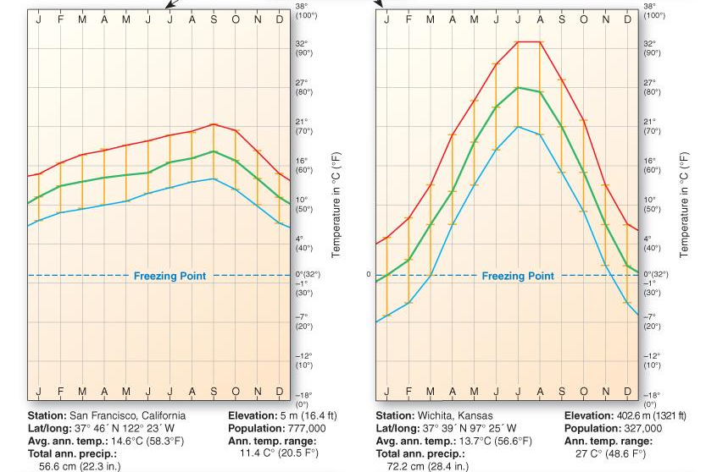
Marine Effect vs. Continentality

Slide 26
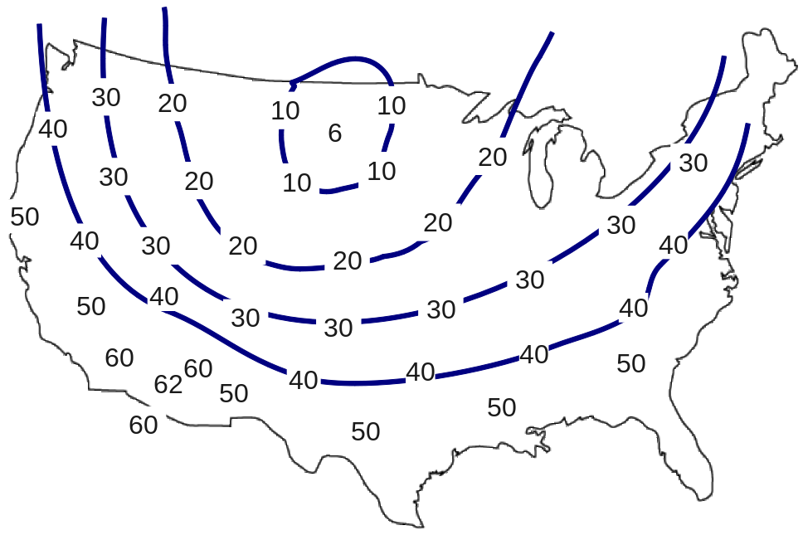
Earth’s Temperature Patterns
Isotherm – a line on a temperature map that connects points of equal temperature
Thermal equator – isotherm connecting all points of highest mean temperature
Shifts with seasons

Slide 27
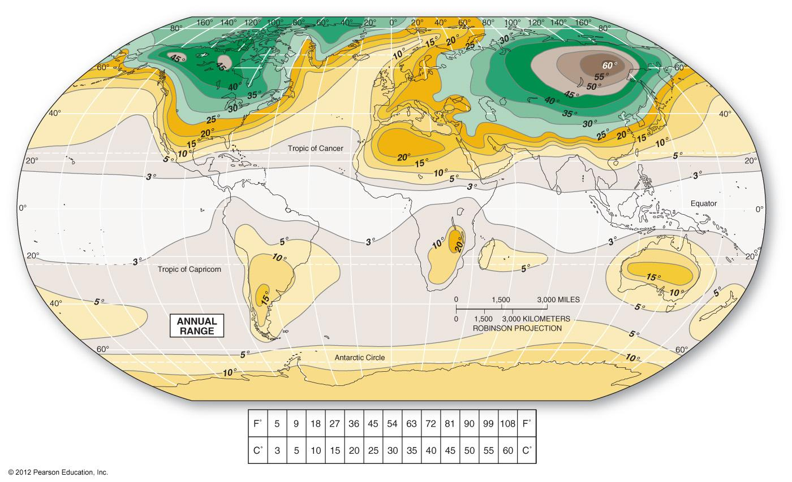
Annual Temp Range Maps
Highlights areas of high to low temp range (difference between hottest summer temp and coldest winter temp).
Why are areas of greatest difference mainly in the North?

Slide 28
Looking Ahead
We have now covered all that we will cover from Chps. 1-3 (relevant topics will build, but we are moving on to Chp. 4 in Week 4)
Lab #4 is next week!

